Slide 1
Lexical functional load predicts the direction of phoneme system change
SCIHS Berkeley 2014
Andrew Wedel
University of Arizona
Scott Jackson
University of Maryland
Abby Kaplan
University of Utah

Slide 2
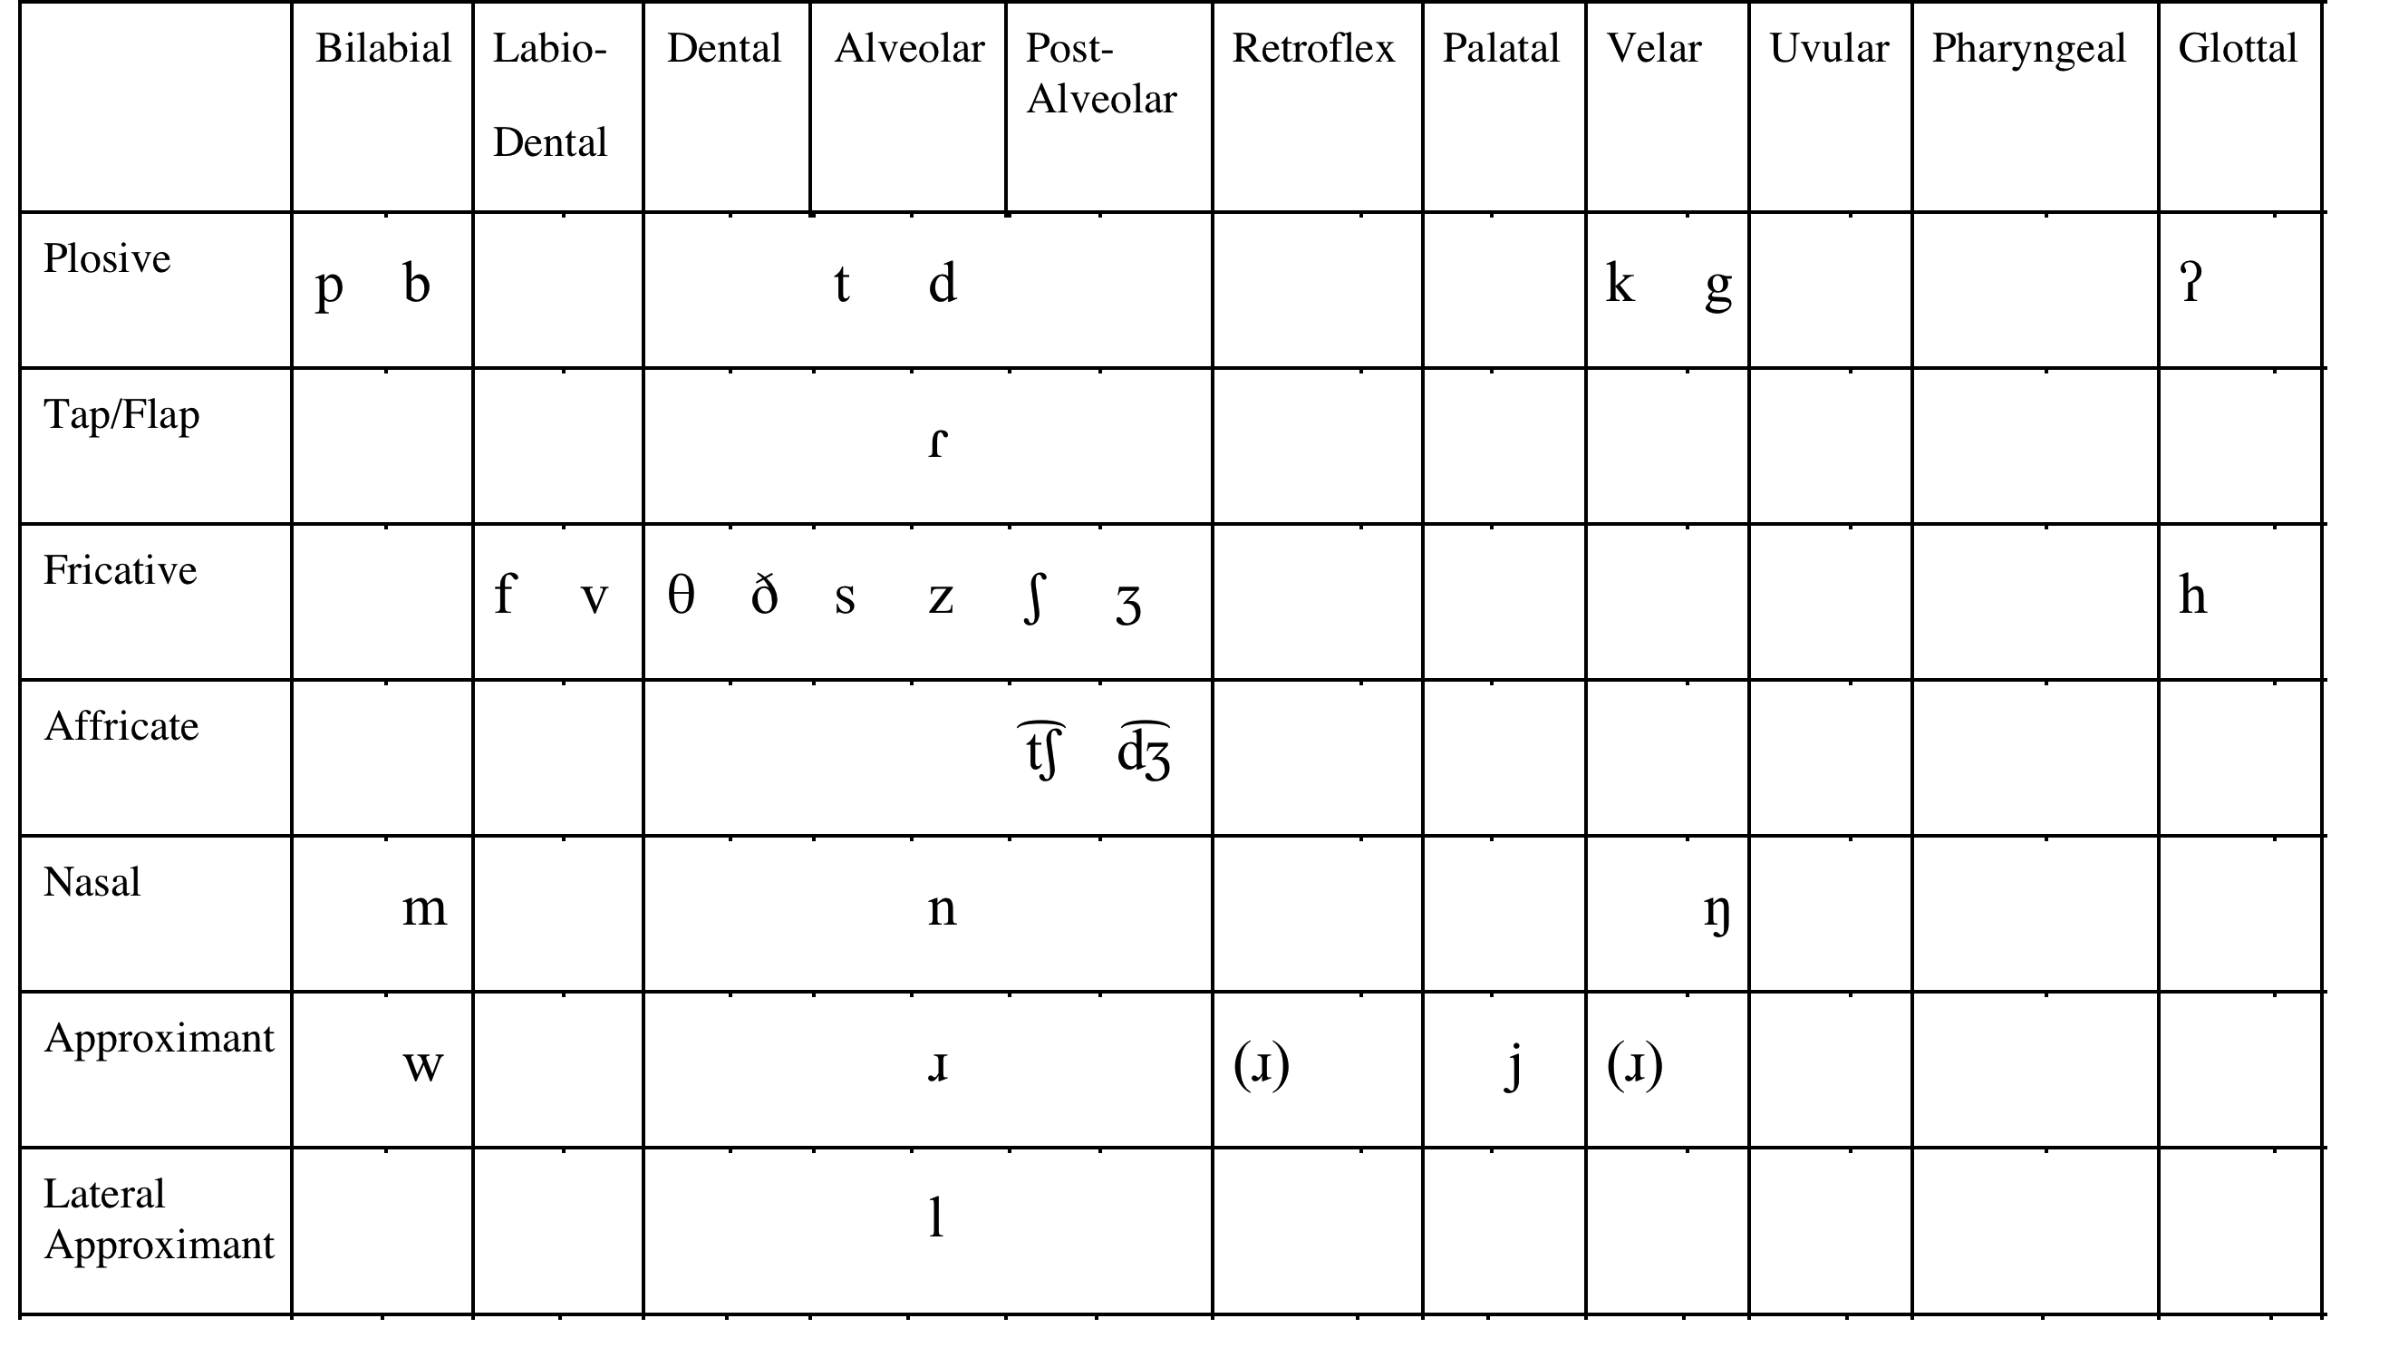
Phoneme inventories change over time

Slide 3
Re-revisiting a very old idea
Does the functional load of a phoneme contrast influence its trajectory of change?
  Gilliéron (1918), Jakobson (1931), Mathesius (1931), Trubetzkoy (1939)
  Martinet (1952), King (1967), Hockett (1967)
  Surendran & Niyogi (2006), Silverman (2011), Kaplan (2011)

Slide 4
Previous work
Previous work examining phoneme mergers has involved case-studies:
  Find a phoneme merger or set of mergers
  Assess the change in the system given your favorite measure of ‘functional load’
  Compare to some set of phoneme contrasts that have not merged.
  Is the change in the system smaller for the actual mergers than for the non-mergers…?
Notes:
Our approach: pool data, hierarchical model, compare predictors, diachronically recent changes,

Slide 5
The database
Nine languages
  American English, British English, Dutch, German, French, Spanish, Slovak, Korean, Hong Kong Cantonese, Turkish
Each row in the data = one phoneme contrast
  e.g., /i ~e/
  All contrasts differ by one basic phonological feature
Dependent variable: dichotomous “merger” or “no merger”
Predictor variables for each phoneme pair
  Number of minimal content-word pairs distinguished by the contrast (and various transformations)
  Frequency information (for phoneme and word occurrences, lemma & lexeme)
  Entropy change (following Surendran & Niyogi 2006)

Slide 6
Basic result:
Number of minimal pairs is significantly, inversely correlated with merger
Wedel, Kaplan & Jackson. 2013. Cognition 128: 179–186
Wedel, Jackson & Kaplan. 2013. Language and Speech 56 :395-417

Slide 7
Refining the model: what kind of minimal pairs?
Lemma vs word form?
Within vs Between Category?
Frequency?

Slide 8
What does not seem to substitute for minimal pairs in this effect?
Broader Lexical measures
  neighborhood measures
  lexical entropy change
Sublexical measures
  sublexical entropy changes
  uniphone, biphone, triphone probabilities
  ? probabilities of sublexical ‘prefix’ competitors (cf. Cohen-Priva 2012))

Slide 9
Intriguing: Higher phoneme frequency is positively correlated with merger
…but only for phoneme pairs that don’t distinguish minimal pairs.

Slide 10
What about changes that might index avoidance of merger?
With Scott Jackson
Phoneme Shift: concerted shift of a phoneme pair in the same dimensional space.
Phoneme Split: merger of a contrast associated with enhancement of an associated contrast in a different dimension.

Slide 11
What do shifts and splits have in common?
A sound change that threatens a cue to lexical identity is compensated by some other change.
  Note: shifts and splits do not share the same effect on the phoneme inventory.
    A shift leaves the phoneme inventory unchanged
    A split merges one phonemic contrast, while creating a new one.

Slide 12
Mergers, Shifts, Splits versus No reported change
phoneme splits/shifts
phoneme mergers

Slide 13
Predicting direction of change
Given a phoneme-inventory change, was it
  a change that reduces lexical contrast?
    a merger
  a change that preserves lexical contrast?
    a shift or a split

Slide 14
YES: Given a change, median MP count predicts change type with over 80% accuracy
Merger
Shift/Split
log minimal lemma pair count

Slide 15
Individual datasets

Slide 16
Predicting change itself
Is sound change predicted by minimal pair count?
  Group all change-types together and compare to the set of phoneme pairs for which no change is reported.

Slide 17
Not obviously: Distribution of MP counts does not differ between the change vs no-change group
(K-S test, p > .60)

Slide 18
Some specific conclusions
The distribution of a phonological contrast across the lexicon strongly influences the trajectory of change in that phonological contrast.
  Within-category minimal lemma pairs are most closely associated with this effect.
  Lemma frequency does not appear to be a strong factor.

Slide 19
Opportunities and pitfalls with
Variationist/Usage Based/Evolutionary (VUE) models
Exciting explanatory power
Hypothesis testing is non-trivial
  cf. hypotheses in the evolution of species and ‘just-so’ stories
Need good model systems
  look for particular contexts in which hypotheses are maximally distinct

Slide 20
Lexicon-Phonology Interaction is a model model system…
The mapping between phoneme sequences and lexical categories in a language is relatively unconstrained.
  Both generative and VUE models agree here.
Both lexical and phoneme-level measures are relatively easy to obtain.

Slide 21
Acknowledgements
Thanks to:
Scott Jackson
Abby Kaplan
Ben Martin
Adam Ussishkin
Bodo Winter

Slide 22
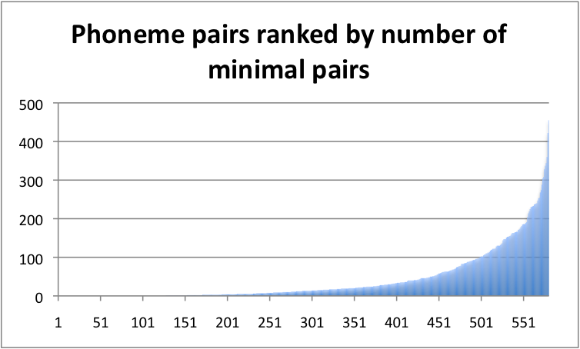
Number of minimal pairs
Attested mergers in the dataset
Rank of phoneme-pairs by number of minimal pairs

Slide 23
Database of Shifts/Splits
Shifts
  Spanish voiced/voiceless stop pairs
    Lewis 2000
  American English vowel shifts: Northern cities, Southern Shift
    Labov et al. 2006
  NZ English front vowel shifts
    Hay, Macglagan, & Gordon 2008
  Polder Dutch diphthongs
    Jacobi 2009
  Canadian French vowel shift
    Walker 1983

Slide 24
Database of Shifts/Splits
Splits
  Pittsburgh /ɑʊ ~ ʌ/, Inland North /e ~ ɑ/ → vowel length
    Labov et al, 2006
  English coda obstruent devoicing → vowel length
    Purnell et al. 2005
  Turkish ɣ deletion → vowel length
    Lewis 1967
  NZE /dress ~ fleece/ → diphthongization
    Maclagan and Hay, 2005
  Korean onsets /lax ~ aspirated/ → tone
    Silva 2006

Slide 25
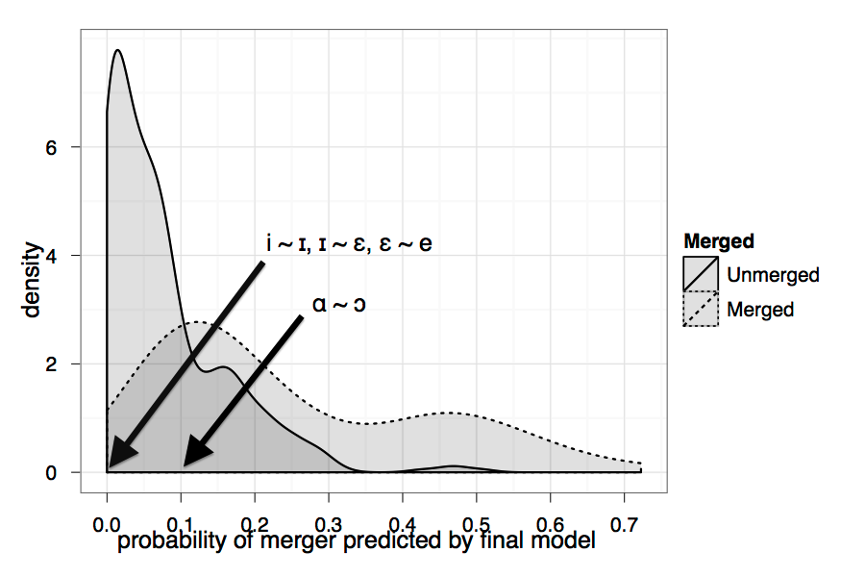
Example model predictions
American English

Slide 26
Approaches to assessing the functional load of a phonemic contrast
At the level of the phoneme inventory
  Phoneme-level entropy change
    King 1967, Hockett 1967, Surendran & Niyogi 2006
At the level of the lexicon
  Lexicon-level entropy change
    Surendran & Niyogi, Kaplan 2011
  Lexical competition
    Minimal pairs: Silverman 2011, Kaplan 2011
    Cohorts/Prefixes: Cohen-Priva 2012
Notes:
Pool data from multiple languages
Assess diachronically recent changes
Pooled analysis (hierarchical model) to compare a range of predictor variables (lexical & phoneme-level)

