Slide 1
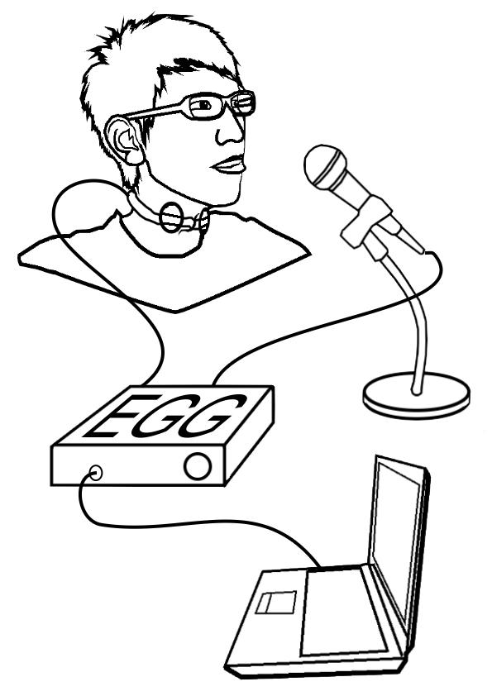
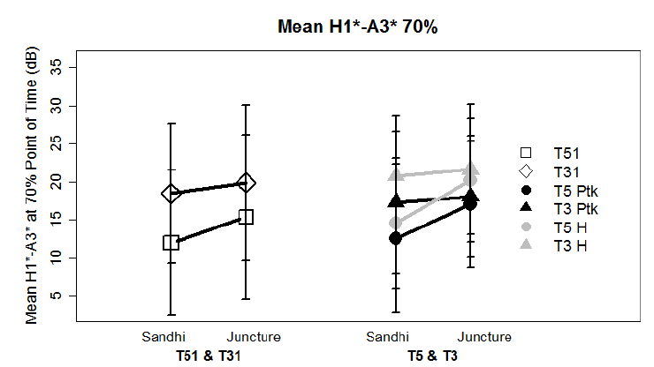
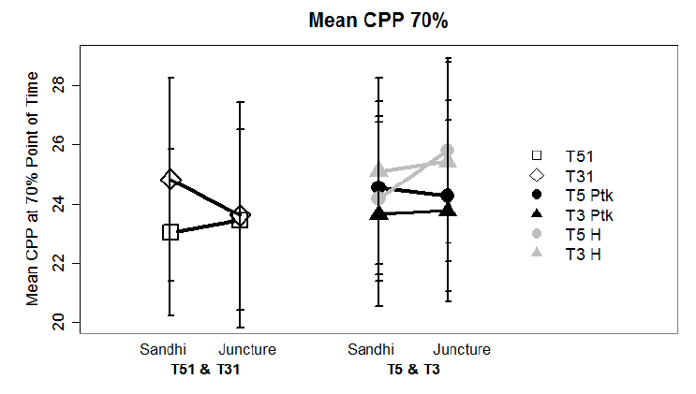
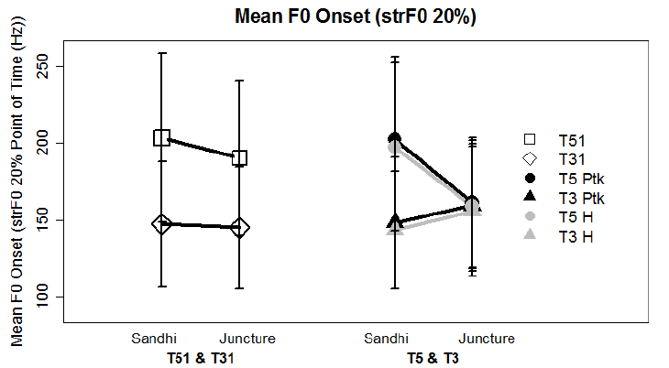
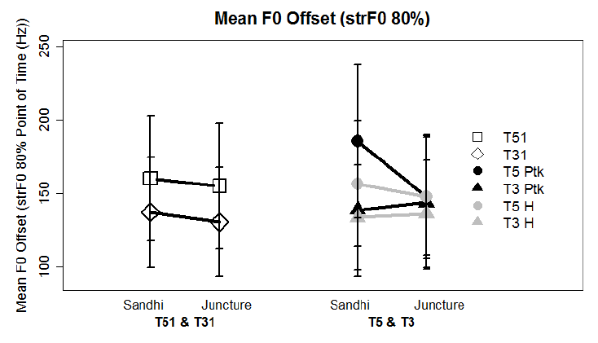
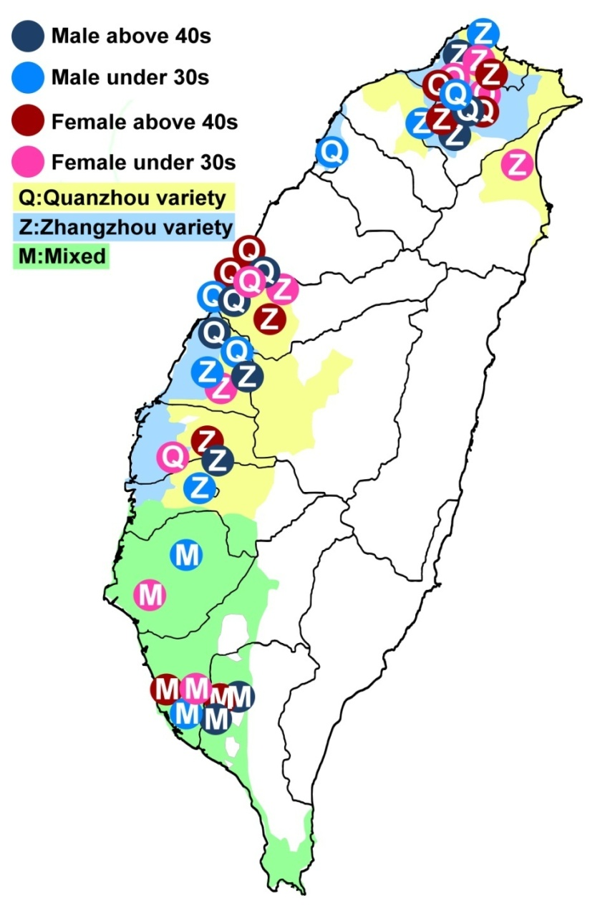
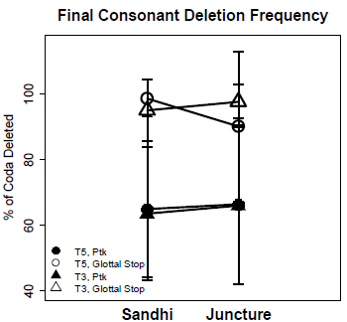
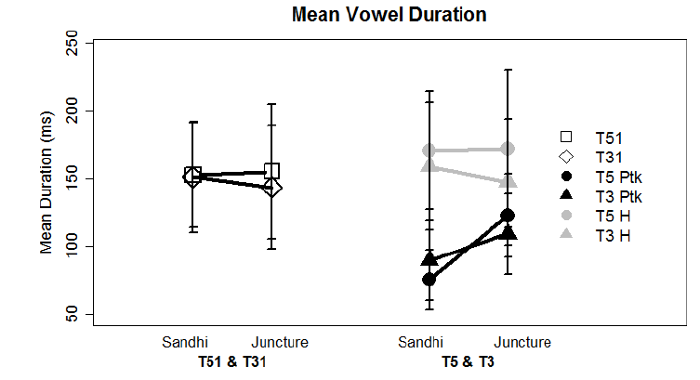
Taiwan Min Checked Tone Change
Ho-hsien Pan, Fang-Yi Jian, Chia-Jou Liu and Hsiao-Tung Huang
hhpan@faculty.nctu.edu.tw
National Chiao Tung University, TAIWAN
Taiwan Min Checked Tones
Uniqueness
CV[p, t, k, ʔ]
Short duration
Glottalized voice qualtiy
Tones Sandhi Rules
Tone /5/ → [3] / _σ # _{[tone group boundary]}
- Juncture tone 5 → Sandhi tone 3 at non-final position
Tone /3/ → [5] / _σ # _{[tone group boundary]}
- Juncture tone 3 → Sandhi tone 5 at non-final position
b) Juncture tone 5 sound change
/pe ʔ 5/ → [pe33] “White”
- final coda deletion
- vowel lengthening
- tone lowering
- voice quality become modal like
(Liao, 2004, Chen, 2010, Ang, 2003)
2. Research Questions
Are juncture tone 3, sandhi tone 5 & 3 undergoing same changes?
c) Experimental Procedure
Acoustical and EGG Recording
Data Analysis
Praat : Segmentation and Tagging
VoiceSauce: Extract acoustical parameters
R : Mixed effect linear regression
c) Voice Quality
Juncture Tones 5: Higher H1*-A3* → less tense
Juncture tones 3 & 5 Merging
[ʔ]: Higher CPP → more periodic voice
F0 Merging
Juncture Tone 5: F0 onset and offset decrease
Juncture Tone 3: F0 onset and offset increase
Discussion
Coda deletion may lead to vowel lengthening and periodic voice quality
F0 merging between juncture tones 3 and 5 may be perceptually motivated.
Begin from low frequency juncture form
Perceptual confusion due to
- either phonetic Similarity
- allophonic Relationship
Acknowledgement
Grant support from Ministry of Science and Technology, TAIWAN
(NSC-102-2410-H-009-015-MY2)
Examples
Underlying Representation | Phonetic Representation | Chinese Translation | English Translation
/tok5 lip5/ | [tok3 lip5] | 獨立 | Independent
/dʒek3 peʔ3/ | [dʒek5 peʔ3] | 叔伯 | Fraternal uncle
Measure | Description
Duration | Vowel duration (ms)
F0 Onset and Offset | F0 measured at 20% and 80% vowel intervals (Hz)
F0 Range | F0 at 20% -F0 at 80% vowel Interval (Hz)
A2* at vowel 70% | Amplitude of the strongest harmonic of 2nd formant (dB)
H1*-A3* at vowel 70% | Spectral tilt. Amplitude differences between the first harmonic and the strongest harmonic of the third formant (dB) (higher = less tense)
CPP at vowel 70% | The amplitude of harmonics above the noise floor. Measure of periodicity of vocal fold vibration. (higher amplitude = more periodic)
***
***
**
***
***
***
***
***
*
**
Method
Subjects
40 speakers:
{[(2 males + 2 females)
× 2 ages]
× 5 dialect regions}
Corpus
472 Disyllabic words embedded in carrier sentence:
“Please listen to the tone of _______ first.”
Results
Coda Deletion
Above 90% coda [ʔ] deletion
60-70% coda [p, t, k] deletion
Duration Lengthening
[ʔ ]: Duration lengthening
***
Tones
Filler | 55, 13, 33
Control | S51: 40 J51: 56 S31: 44 J31: 36
Target | S5: 109 J5: 70 S3: 122 J3: 95

