Slide 1
Tongue body correlates of the coronal contrast in Kaytetye: an ultrasound investigation
Susan Lin¹, Mark Harvey², Benjamin Davies³, Myfany Turpin⁴, Katherine Demuth^{1,3}, Alison Ross⁵
¹ARC Centre for Excellence in Cognition and its Disorders, ²University of Newcastle, ³Macquarie University,
⁴University of Queensland,
⁵Northern Territories Government, Department of Education

Slide 2
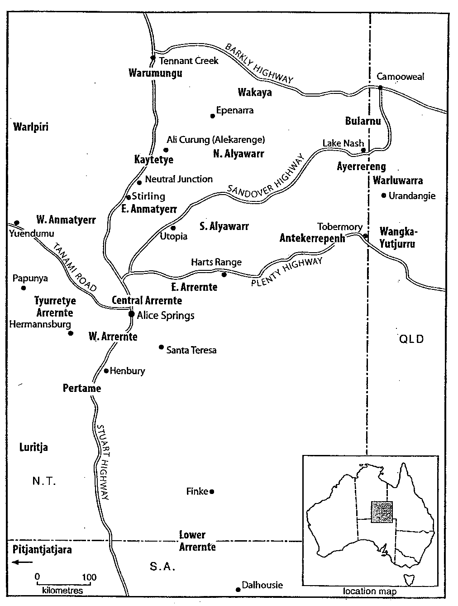
Kaytetye
Arandic language spoken north of Alice Springs, NT
Notes:
Kaytetye is an Arandic language spoken roughly 300 km north of Alice Springs

Slide 3
Kaytetye: coronal consonants
 | alveolar | retroflex | dental | palatal
oral stop | t | ʈ | t̪ | c
nasal stop | n | ɳ | n̪ | ɲ
pre-stopped nasal | ^{t}n | ^{ʈ}ɳ | ^{t̪}n̪ | ^{c}ɲ
lateral | l | ɭ | l̪ | ʎ
Notes:
Like many Arandic languages, Kaytetye has a four-way coronal contrast – alveolar, retroflex, dental and palatal – found in four consonant series, both oral and nasal stops, pre-stopped nasals, and laterals, although in this talk we’ll be exploring the oral stop series.

Slide 4
Research Goals
What are the tongue body correlates of these coronal stops?
Can these stops be distinguished from one another by tongue body posture alone?
Notes:
As an exploratory study, we have a very simple goal – to explore the articulatory differences between the coronal consonants in Kaytetye.
But to help guide us, we’ll ask a couple relatively broad questions.
First, what are the tongue body correlates of Kaytetye coronal stops, and can the stops be distinguished from one another using these tongue body postures alone?

Slide 5
Methods: stimuli & participants
Target stimuli: 2-4 syllable Kaytetye words with /#a.CV/, where C is
  a stop {/t/, /ʈ/, /t̪/, c}
  V is either /ə/ or /a/
  at least 2 words in each segmental category
Participants: 7 female Kaytetye speakers
  ages 38-62
  residents of Stirling and Neutral Junction, NT
Notes:
In this study, we collected productions of real Kaytetye 2-4 syllable words, where the target oral stops were the first consonant in the word.
It’s important for our discussion later to note that the target stops were always preceded by the vowel /a/, and were followed by either ə or a.
Our participants were seven female speakers of Kaytetye, whose ages ranged between 38 and 62. All were residents of Stirling, where the data were recorded, or nearby Neutral Junction.

Slide 6
Methods: procedure
Target words in carrier phrase
  /aŋgənəŋə ____/ “Say _____!”
Elicited imitation
  prerecorded audio of female Kaytetye speaker
  image of target word
  participants asked to say each sentence twice
4-6 repetitions of each prompt
  Total of 8-12 repetitions of each target item
Notes:
The target words were placed in a carrier phrase, meaning “Say ___”, and were pre-recorded by another female speaker of Kaytetye.
These recordings were coupled with an image of the target word, which were shown to the participants while the recording played.
Following the prompt, participants were asked to say each sentence twice, and we obtained a total of 8-12 repetitions of each item.

Slide 7
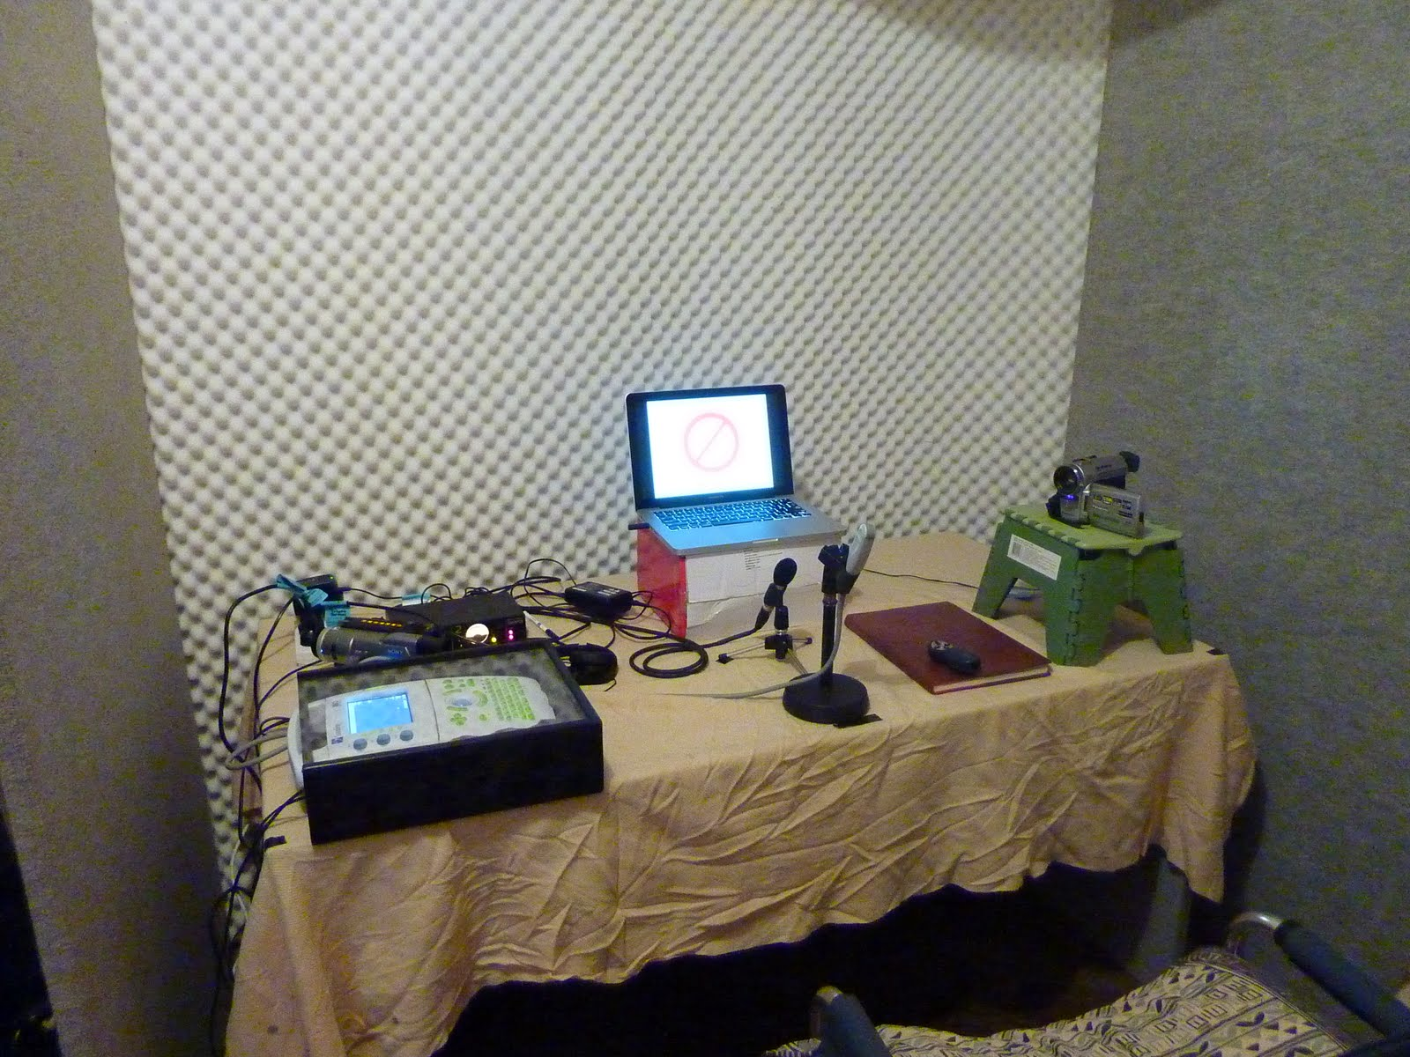
Methods: data collection
Ultrasound video and audio captured via external camcorder
29.97 fps (NTSC)
Notes:
Articulatory data were captured using ultrasound video, which was streamed to an external camcorder that mixed together the ultrasound video and audio.
The video was recorded at NTCS standard of 29.97 fps.

Slide 8
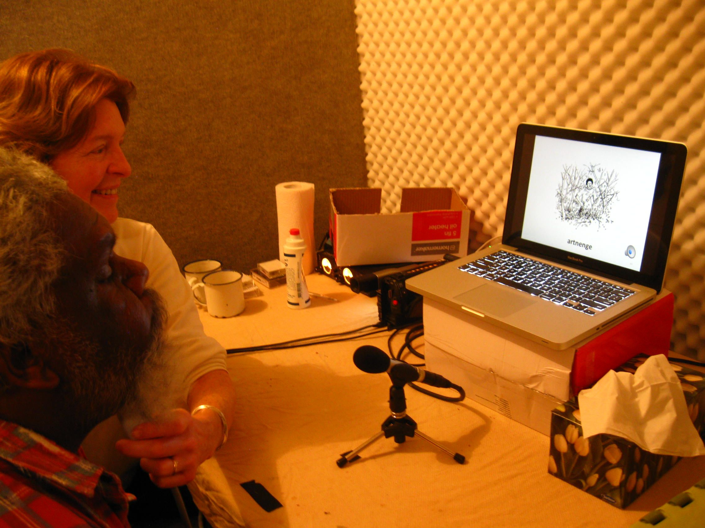
Methods: ultrasound
Ultrasound probe under participants’ chin
midsagittal view of oral cavity
probe held by experimenters
Notes:
The probe was held under participants’ chins by the experimenters, with the probe positioned to capture midsagittal view of the oral cavity.
The experimenter holding the probe was able to view the ultrasound during recording, and was therefore able to adjust the probe’s position if necessary, to manually correct for participants’ head movement.
(The participant pictured here is clearly not one of the 7 female speakers examined in this talk. We collected data from 11 individuals altogether, but have excluded four for either having unusable ultrasound video or if Kaytetye was not the individuals’ primary language.)

Slide 9
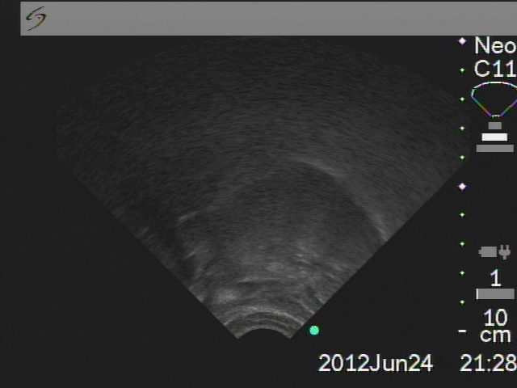
Ultrasound example: t - ateke
Notes:
In this and all other ultrasound images shown in this talk, the front of the oral cavity is on the right, and the back is on the left.

Slide 10
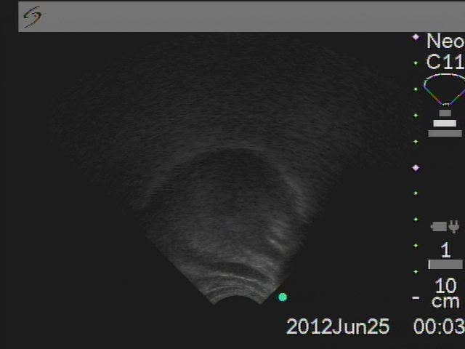
Ultrasound example: t̪ - athenge

Slide 11
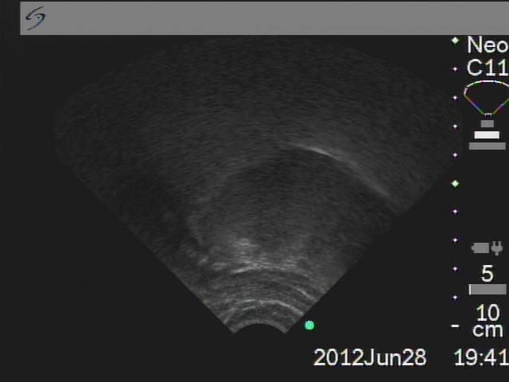
Ultrasound example: ʈ - artepe

Slide 12
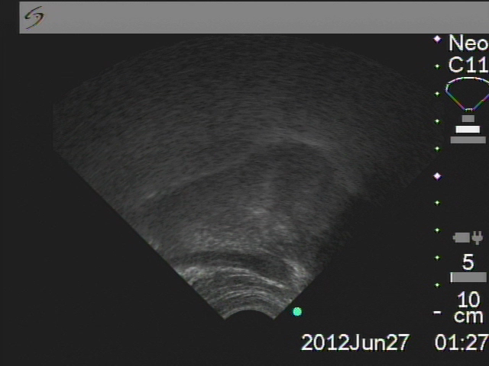
Ultrasound example: c - atyepe

Slide 13
Methods: post-processing
Video and audio from DV tapes extracted
  Final Cut Pro X v 10.0
Audio examined in Praat
  onset and offset of each segment in /#a.CV/ marked
  corresponding frames extracted automatically
Notes:
Video and audio from the camcorder tapes were extracted, and audio marked in Praat for the onset and offset of each target segment in the /#a.CV/ sequence
The corresponding frames from each sequence were extracted automatically using these time stamps.

Slide 14
Methods: post-processing
Two frames in each sequence selected
  vocalic: stable vowel production during preceding V (/a/)
  consonantal: point of maximal lingual excursion during C
Vocalic and consonantal frames superimposed
  consonantal frame colored black & red
  vocalic frame remains black & white
Notes:
From each sequence, two frames were selected.
The first representing the stable tongue configuration during production of the preceding vowel, and the second representing the point of maximal lingual excursion during production of the target oral stop.
Then the vocalic and consonantal frames were superimposed, with the consonantal frame colored red and black.

Slide 15
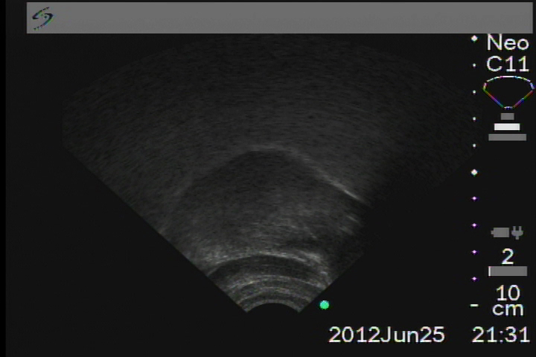
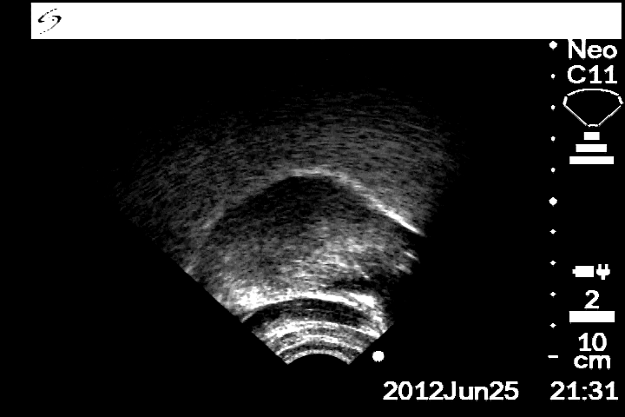
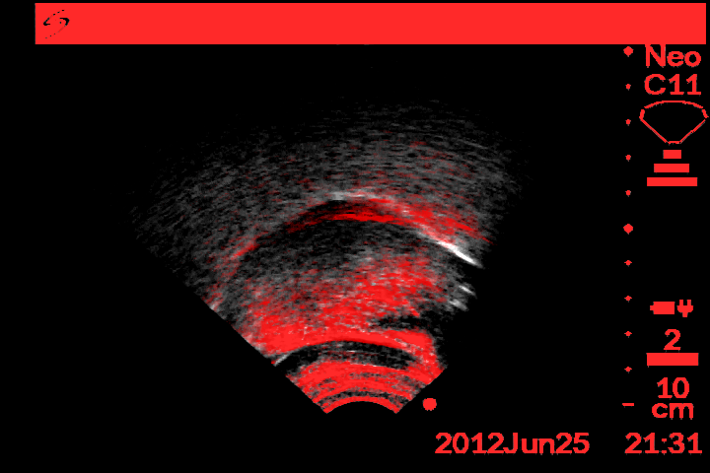
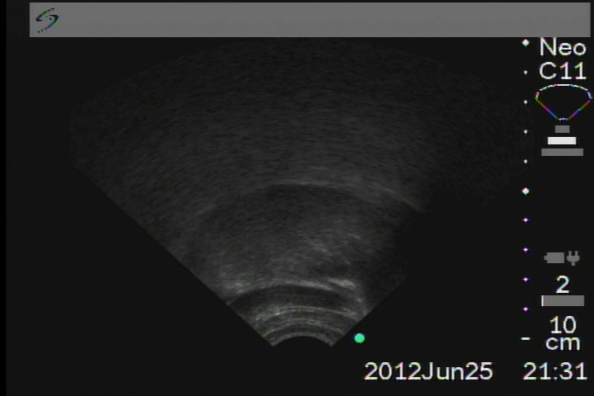
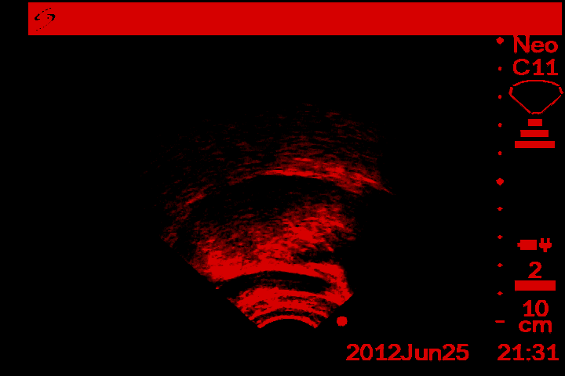
Methods: post-processing
dental /t̪/
vowel
consonant
Notes:
Like so.

Slide 16
Methods: post-processing
palatal /c/
Image divided into 3 sections
  back: tongue dorsum
  mid: tongue body
  front: tongue blade / tip
retroflex /ʈ/
Notes:
Each combined image was then divided into 3 sections, separating the visible oral cavity into a back, mid and front region.
These regions were determined visually, and roughly divide the tongue into dorsum (or posterior body), body (or anterior body), and blade and tip regions.

Slide 17
Analysis: ultrasound categorization
For each item, every section was assigned a value comparing the consonantal (red) contour to the preceding vocalic (white) contour
  Front: raised / lowered / stable
  Mid: raised / lowered / stable
  Back: forward / backward / stable
palatal /c/
Front: raised
Mid: raised
Back: forward
Notes:
And for each section of each item, the red consonantal contour was compared against the white vowel contour, and was assigned a value representing the aggregate movement of the tongue in the given region.
So for this palatal stop, for instance, the tongue during constriction is comparatively raised in the front region, raised in the mid region, and forward in the back region.

Slide 18
Results: variability and consistency
Most stops consistent within and between speakers
  all stops consistently raised in front region
  alveolar: stable back and mid
  dental: stable back and lowered mid
  palatal: fronted back and raised mid
Retroflex stops inconsistent
  back: forward or stable (most speakers forward)
  mid: raised or lowered (intra-speaker variability)
Notes:
Now, for the most part, articulations were reasonably consistent both within and between speakers, for alveolar, dental and palatal stops.
However, retroflex stops were variable within speaker.
In the following slides we’ll take a closer look at productions of each type of oral stop, with prototypical examples for each.

Slide 19
Research Goals
What are the tongue body correlates of these coronal stops?
Can these stops be distinguished from one another by tongue body posture alone?

Slide 20
Results: t (alveolar)
Front: raised
Mid: stable / raised
Back: stable
Minimal movement of tongue dorsum and body
Hinge-like action of tongue blade / tip
Notes:
For the most part, our participants produced alveolar t with a simple hinge-like action of the tongue blade and tip upwards to meet the alveolar ridge.
Most participants’ productions involved minimal movement in the back or mid regions, indicating relative stability of the tongue between the vowel and consonant.
Some productions included some raising in the mid region, such as this example here, but in these cases, the raising appears to occur from a point along the tongue forward, while the contour of the tongue behind the point remains stable.

Slide 21
Results: t̪ (dental)
Front: raised
Mid: lowered
Back: stable
Minimal movement of tongue dorsum
Substantial lowering movement of tongue body
Raised (and advanced) tongue blade / tip
Notes:
Dental t was produced quite differently, with most productions involving a raised front, a lowered mid, and a stable back region.
This isn’t surprising, and we suggest that the substantial advancement of the tongue blade and tip required for production of the dental (which was, in some cases, actually inter-dental), causes lowering of the tongue body.

Slide 22
Results: c (palatal)
Front: raised
Mid: raised
Back: forward
Extreme forward and raising movement of blade
Requires forward movement of entire tongue, reflected in forward rating for tongue back region
Notes:
Palatal c productions were similarly not surprising.
The extreme forward and raising movement of the tongue blade, which is a requirement for formation of a palatal constriction, in turn requires forwards movement of the whole tongue.
That advancement is reflected in the forward rating of the tongue in the back region.

Slide 23
Results: ʈ (retroflex)
Front: raised
Mid: stable / lowered
Back: forward
Raising of tongue tip / blade
Slight fronting of tongue dorsum
Inconsistent / minimal lowering of tongue body
Notes:
However, instead, we found that our participants either demonstrated tongue body advancement, reflected in a “forward” rating for the back region, as in this production, or…

Slide 24
Results: ʈ (retroflex) alternate
Front: raised
Mid: stable
Back: stable
Raising of tongue tip / blade
Minimal raising of tongue body
Notes:
demonstrated an essentially stable tongue contour in both the back and mid regions, similar to prototypical alveolars.

Slide 25
Retroflexes: why more variable?
Laminals (dental, palatal)
  Dental: extreme forward movement of tongue blade to achieve dental constriction
  Palatal: extreme forward and upward movement of tongue body for post-alveolar constriction
Apicals (alveolar, retroflex)
  Alveolar: upward movement of tongue tip to achieve alveolar constriction
  Retroflex: upward movement of tongue blade

Slide 26
Results:
Criteria for consistency: 75%
 |  | Back |  |  |  |  | Mid |  |  |  |  | Front
 |  | forward |  | stable |  | backward | lowered |  | stable |  | raised | raised
✓ | t |  | 2 | 5 |  |  |  | 1 | 6 |  |  | 7
✓ | t̪ |  |  | 5 | 2 |  | 5 | 2 |  |  |  | 7
✓ | c | 5 |  | 2 |  |  |  |  | 1 |  | 6 | 7
✗ | ʈ | 4 | 1 | 2 |  |  |  | 5 | 1 | 1 |  | 7
Number of speakers in each movement category
Notes:
In this table, the values in the columns in each region represent the number of speakers who consistently produced the the stops with the listed movements.
You’ll notice that there are, in each region, five columns, rather than three. The three named columns represent speakers for whom at least 75% of the stops produced demonstrated movement in that direction.
For the intermediate (unnamed) columns, these represent speakers for whom productions varied between two categories, and where the majority category was not over 75%.
So, unsurprisingly, all speakers were consistent raisers in the front region for all stops.
Also, as expected, in production of the dental stop, the majority of our participants lowered their tongue body, and in productions of the palatal stop, most demonstrated substantial raising and fronting of the tongue.
It is also worth noting that, while we had no specific predictions regarding movement of the tongue body during production of the alveolar stop, our participants were quite consistent in maintaining a stable tongue body.
However, productions of the retroflex stop ran counter our expectations, based on the proposed relationship between tongue backing and retroflexion. Despite some inter-speaker variability with respect to tongue movement in the back region, *no* speaker demonstrated tongue backing – the variability remains in the forwards and stable columns.

Slide 27
Research Goals
What are the tongue body correlates of these coronal stops?
Can these stops be distinguished from one another by tongue body posture alone?
  Yes …
  … except between alveolar and retroflex

Slide 28
Retroflexes: previous accounts
Proposed relationship between retroflexion and tongue body retraction
  Categorical (Boersma & Hamann, 2005; Hamann 2003)
  Preferrential (Flemming 2003)
(Hamann 2003)
Notes:
Now, retroflex ʈ come with a set of expectations, from the phonology literature, in which there is a proposed relationship, whether categorical or preferential, between retroflexion and tongue body retraction.
This figure is taken from Hamann’s 2003 dissertation on retroflex consonants, in which she proposes that this retraction is an articulatory reflex of the degree of tongue tip raising and bending required for retroflexion. The light gray trace represents the tongue “at rest” while the black trace represent the tongue during retroflexion.

Slide 29
Retroflexes: conflicts with previous accounts
Does retroflexion require retraction?
Kaytetye and Kanada (Kochetov et al. 2012)
  Despite both between and within speaker variability, no tongue body retraction
preceding
vowel
retroflex ʈ
(Kochetov et al. 2012)
Notes:
So data from our Kaytetye speakers, as well as recent findings from Kanada speakers, provide evidence against the notion that retroflexion necessarily requires retraction.
These two images on the side are taken from Kochetov et al’s 2012 study of Kanada speakers, in which, like us, they found tongue advancement, rather than retraction.

Slide 30
Retroflexes: conflicts with previous accounts
Articulatory motivation for retraction
  “to be able to move its tip upward and into a displaced position in the post-alveolar region, [the tongue] stretches and pulls backwards” (Hamann 2003)
But…
  Size / extent of sub-laminal contact
  Vocalic context

Slide 31
Retroflexes: uniting accounts
Size / extent of lingual contact
Vocalic context
Notes:
So, is the proposed relationship between retroflexion and retraction just wrong?
We’d like to suggest at least two other possibilities.

Slide 32
Retroflexes: uniting accounts
Size / extent of lingual contact (Keating 1991)
  Apical: less linguopalatal contact
  Sub-apical: more linguopalatal contact → requires more forward movement of tongue body
  Prediction:
    sub-apical retroflexes more likely to involve tongue advancement
Vocalic context
Hamann (2003) via
Ladefoged and Maddieson (1986)
Notes:
First, it’s quite possible that retroflex consonants in different languages simply require different types of lingual contact.
In fact, both Keating 1991 and Ladefoged and Maddieson 1996 have observed at least two different types of retroflex consonants.
Apical retroflexes involve a more anterior constriction, and less curling of the tongue; sub-apical retroflexes involve a more posterior constriction and more curling of the tongue.
Extreme degrees of tongue curling require lingual stretching, and thus sub-apical retroflexes are more likely than apical retroflexes to involve advancement rather than retraction.

Slide 33
Retroflexes: uniting accounts
Size / extent of lingual contact
Vocalic context
  Present study and Kochetov et al (2012) examined retroflex stops following /a/
  Open vowels (e.g. /a/) require more movement
  Prediction:
    retroflexes in context of open vowels (e.g. /a/) more likely to involve tongue body advancement
    retroflexes in context of close vowels (e.g. /i/) more likely to involve retraction
Notes:
Another possibility is that vowel context plays a role.
Notably, both the present study and Kochetov et al were based on retroflex consonants following /a/.
Since open vowels, such as /a/, involve a wider jaw opening, compared to close, or high, vowels, in order to form a retroflex constriction, quite a lot of raising of the tongue body would be required, which may in turn prohibit retraction.
Therefore, we think it plausible that the relationship between retroflexion and retraction may be language and context dependent, and thus not a universal.

Slide 34
Alveolars: conflicts?
Fronted tongue body preference (Flemming 2003)
Our observations show that the tongue body is generally stable in the production of alveolars preceded by /a/

Slide 35
Future directions
Extend examination to the other series
  Nasals
  Pre-stopped nasals
  Laterals: if similar to English laterals, expect different articulatory norms than in stop series
How do these articulatory distinctions similar compare with
  Australian languages? (Tabain 2009; Proctor et al. 2010)
  non-Australian languages?
Notes:
Where can we go from here?
We of course plan to extend our examination of the coronals to the other consonant series, especially the lateral series. The lateral series is of particular interest, since if Kaytetye laterals are similar to English laterals in utilizing both the tongue tip and tongue dorsum, the articulatory distinctions that hold for the stop series, especially with respect to activity in the back region of the oral cavity, should be dramatically different.
Ultimately we would also like to compare our findings with other researchers’ work documenting and modeling articulators in other Australian languages, as well as other, non-Australian languages.

Slide 36
Acknowledgments
We would like to gratefully acknowledge our participants: Amy Ngamperle, Eileen Ampetyane, Janie Ampetyane, Lena Ngamperle, Carol Thompson, Harry Janima, Elsie Numina, Michael Hayes, Rachel Dinny, Rebecca Numina, Lucy Price, Michael Tyapeyarte and Bronwyn Young
This research was supported by Australian Institute of Aboriginal and Torres Strait Islander Studies, G2011/7654

Slide 37
References
Boersma, P. and Hamann, S. (2005). The violability of backness in retroflex consonants. Rutgers Optimality Archive 713
Flemming, E. (2003). The relationship between coronal place and vowel backness. Phonology 20:335-375
Hamann, S. R. (2003). The phonetics and phonology of retroflexes. PhD thesis, Utrecht University.
Keating, P. (1991). Coronal places of articulation. In Phonetics and Phonology: the Special Status of Coronals, Internal and External Evidence 29-48.
Kochetov, A., Sreedevi, N., Manjula, R., and Kasim, M. (2012). A pilot ultrasound study of Kannada lingual articulations. Journal of Indian Speech and Hearing Association 26:38–49.
Ladefoged, P. and Maddieson I. (1996). Some of the Sounds of the World’s Languages. UCLA Working Papers in Phonetics 64.
Proctor, M., Bundgaard-Nielsen, R. L., Best, C., Goldstein, L., Kroos, C., and Harvey, M. (2010). Articulatory modelling of coronal stop contrasts in Wubuy. In Proceedings of the 13th Australasian International Conference on Speech Science and Technology, 90–93.
Tabain, M. (2009). An EPG study of the alveolar vs. retroflex apical contrast in Central Arrernte. Journal of Phonetics, 37(4):486–501.

Slide 38
Stimulus items
alveolar | atake | a.ʽta.kə
 | ateke | a.ʽtə.kə
 | atenganenye | a.ʽtə.ŋa.nə.ɲə
dental | athenganenye | a.ʽt̪ə.ŋa.nə.ɲə
 | athenge | a.ʽt̪ə.ŋə
 | athepe | a.ʽt̪ə.pə
palatal | atyemeye | a.ʽcə.mi.jə
 | atyepe | a.ʽcə.pə
retroflex | artenganenye | a.ʽʈə.ŋa.nə.ɲə
 | artepe | a.ʽʈə.pə

Slide 39
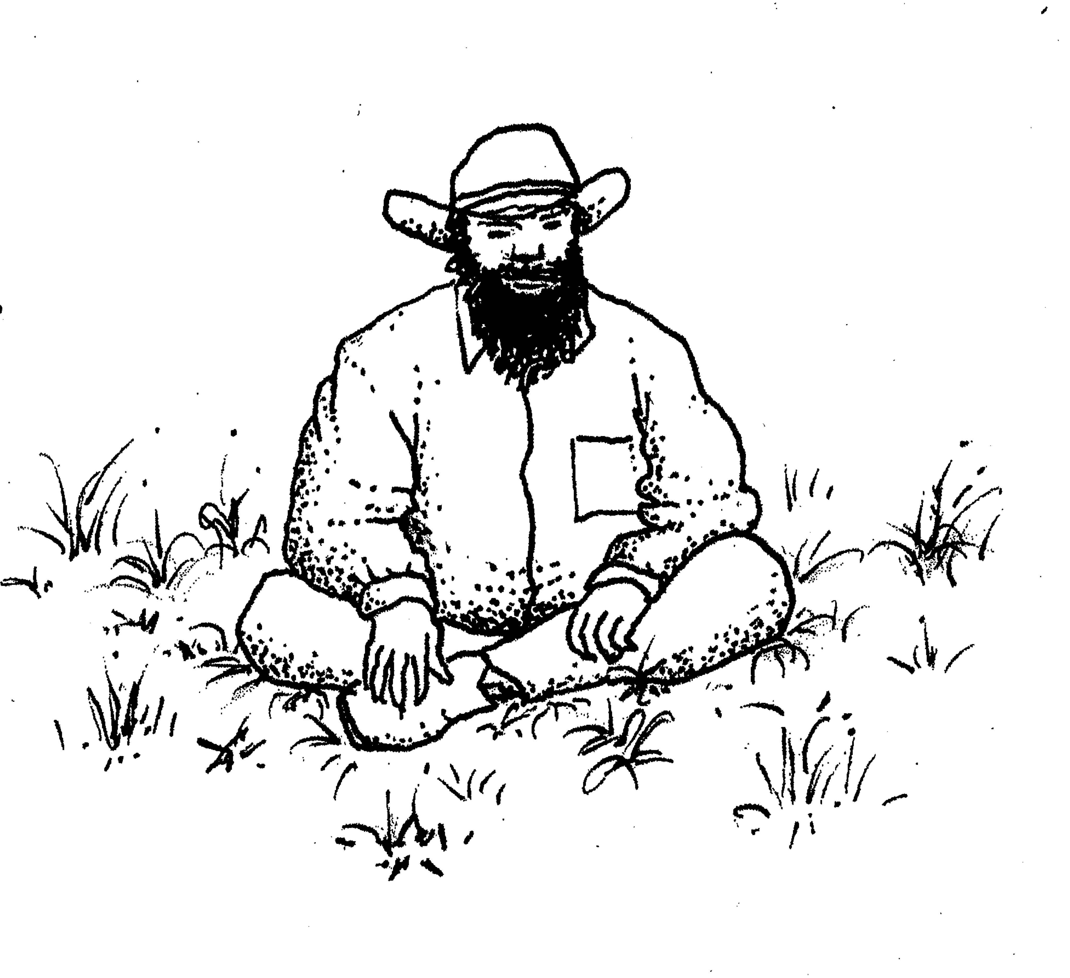

Stimulus slide example
athenge

